Slide 1
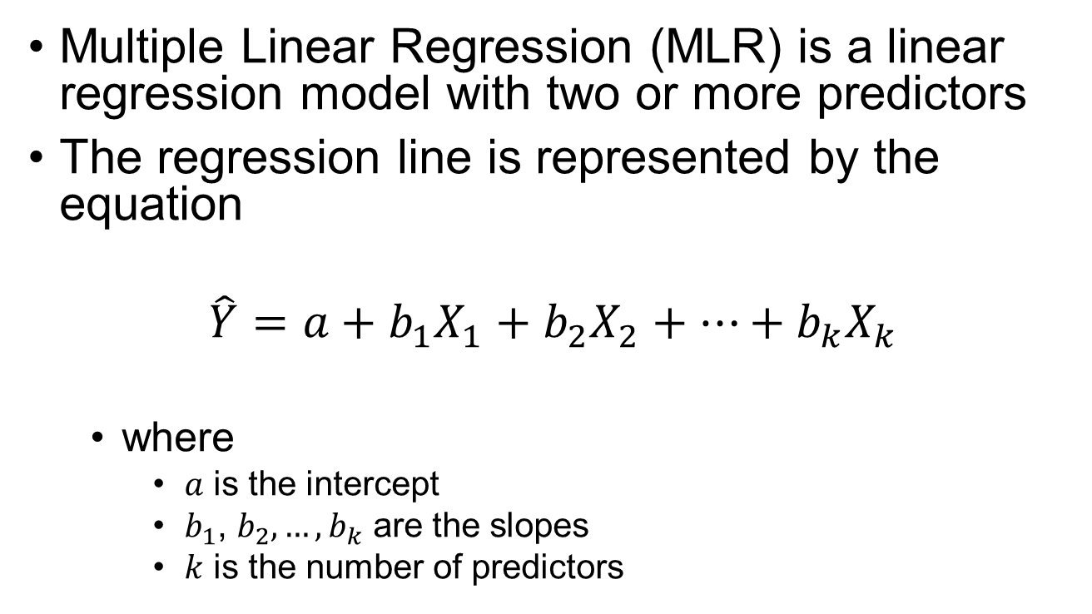
Multiple Linear Regression
Multiple Linear Regression (MLR) is a linear regression model with two or more predictors
The regression line is represented by the equation
$$\hat{Y}=a+b_{1}X_{1}+b_{2}X_{2}+…+b_{k}X_{k}$$
where
$a$ is the intercept
$b_{1}$, $b_{2}, …, b_{k}$ are the slopes
$k$ is the number of predictors

Slide 2
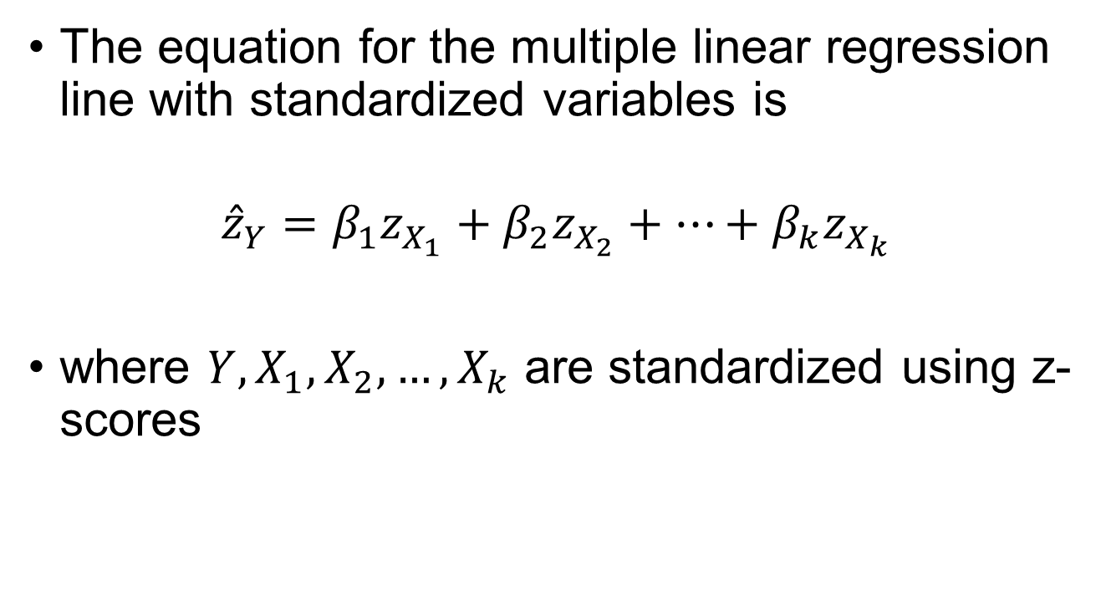
The Standardized MLR Model
The equation for the multiple linear regression line with standardized variables is
$${\hat{z}}_{Y}=β_{1}z_{X_{1}}+β_{2}z_{X_{2}}+…+β_{k}z_{X_{k}}$$
where $Y, X_{1},X_{2}, …, X_{k}$ are standardized using z-scores

Slide 3
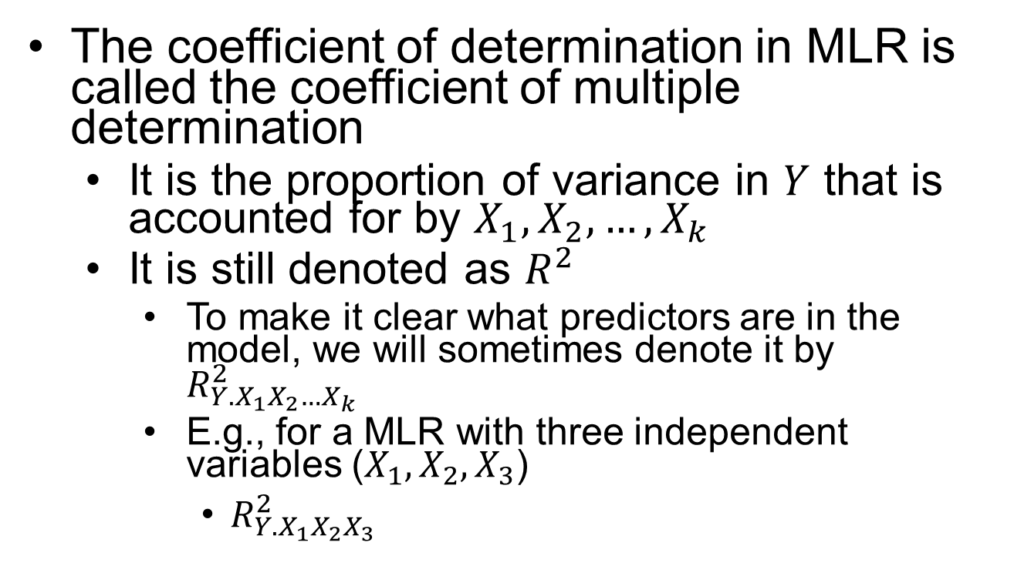
Effect Size in MLR
The coefficient of determination in MLR is called the coefficient of multiple determination
It is the proportion of variance in $Y$ that is accounted for by $X_{1}, X_{2}, …, X_{k}$
It is still denoted as $R^{2}$
To make it clear what predictors are in the model, we will sometimes denote it by $R_{Y.X_{1}X_{2}…X_{k}}^{2}$
E.g., for a MLR with three independent variables ($X_{1}, X_{2}, X_{3}$)
$R_{Y.X_{1}X_{2}X_{3}}^{2}$

Slide 4
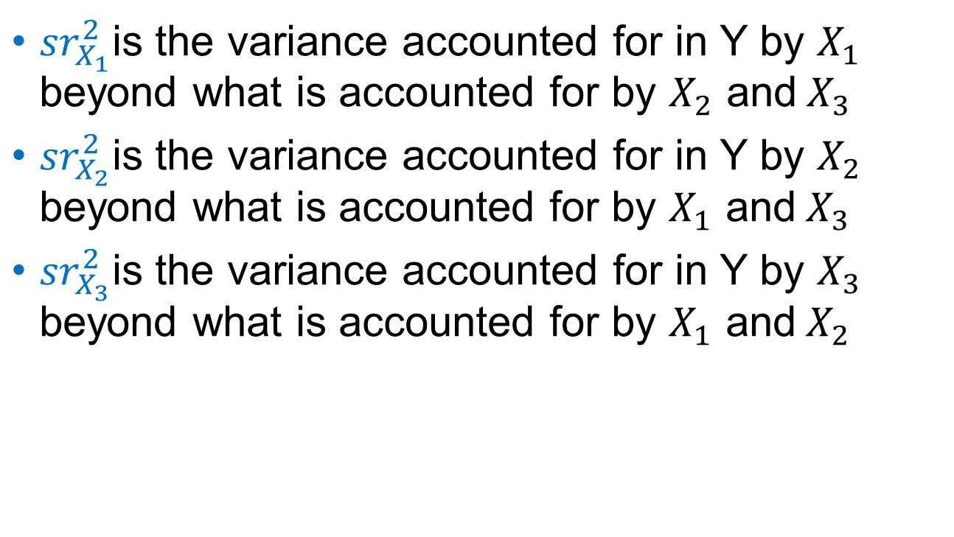
Squared Semipartial Correlation
${sr}_{X_{1}}^{2}$is the variance accounted for in Y by $X_{1}$ beyond what is accounted for by $X_{2}$ and${ X}_{3}$
${sr}_{X_{2}}^{2}$is the variance accounted for in Y by $X_{2}$ beyond what is accounted for by $X_{1}$ and${ X}_{3}$
${sr}_{X_{3}}^{2}$is the variance accounted for in Y by $X_{3}$ beyond what is accounted for by $X_{1}$ and${ X}_{2}$

Slide 5
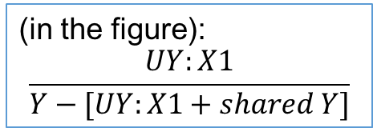
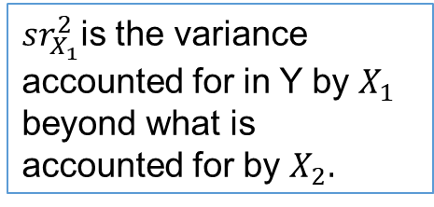
Squared Semipartial Diagram
${sr}_{X_{1}}^{2}$is the variance accounted for in Y by $X_{1}$ beyond what is accounted for by $X_{2}.$
Y
Shared Y
UY:X1
UY:X2
X1
X2
(in the figure):
$$\frac{UY:X1}{Y−[UY:X1+shared Y]}$$
Shared X

Slide 6
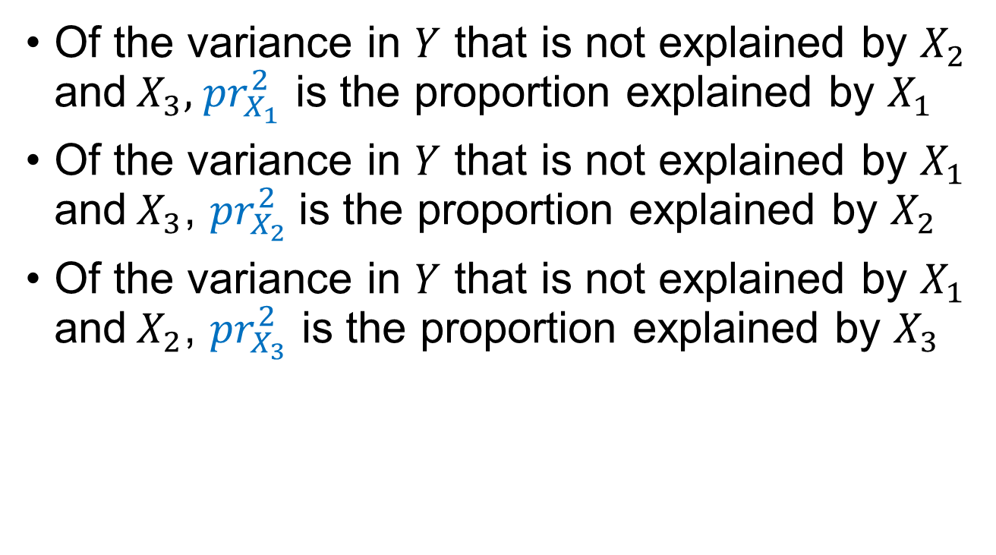
Squared Partial Correlation
Of the variance in $Y$ that is not explained by $X_{2}$ and${ X}_{3}, { pr}_{X_{1}}^{2}$ is the proportion explained by $X_{1}$
Of the variance in $Y$ that is not explained by $X_{1}$ and${ X}_{3}$, ${pr}_{X_{2}}^{2}$is the proportion explained by $X_{2}$
Of the variance in $Y$ that is not explained by $X_{1}$ and${ X}_{2}$, ${pr}_{X_{3}}^{2}$ is the proportion explained by $X_{3}$

Slide 7
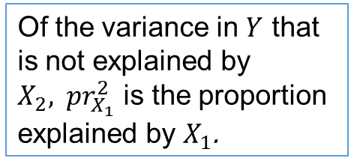
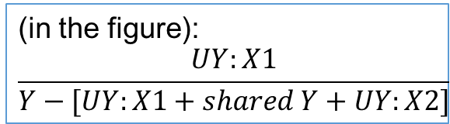
Squared Partial Diagram
Of the variance in $Y$ that is not explained by $X_{2}, { pr}_{X_{1}}^{2}$ is the proportion explained by $X_{1}$.
Y
Shared Y
UY:X1
UY:X2
X1
X2
(in the figure):
$$\frac{UY:X1}{Y−[UY:X1+shared Y+UY:X2]}$$
Shared X
Notes:
The Partial is going to be larger than the semi-partial (for the same variable/data) because we have the same numerator, but our denominator is smaller!

Slide 8
Hypothesis Testing
As with SLR, sample data are used to determine the parameter estimates for the OLS regression line
$$\hat{Y}=a+b_{1}X_{1}+b_{2}X_{2}+…+b_{k}X_{k}$$
But we are truly interested in the population model
$$\hat{Y}=α^{∗}+β_{1}^{∗}X_{1}+β_{2}^{∗}X_{2}+…+β_{k}^{∗}X_{k}$$

Slide 9
Hypothesis Test for $ρ^{2}$
Step 3: Calculate the Test Statistic
This is the F-statistic
Source | SS | df | MS | F
Regression | $$SS_{Regression}$$ | $$k$$ | $$MSR$$ | $${MSR}/{MSE}$$
Error | $$SS_{Error}$$ | $$n−k−1$$ | $$MSE$$
Total | $$SS_{Total}$$ | $$n−1$$

Slide 10
Hypothesis Test for $α^{∗},β_{1}^{∗},β_{2}^{∗}, …,β_{k}^{∗}$
Step 3: Calculate the Test Statistic
This is the t-statistic
$$t=\frac{a}{s_{a}} t=\frac{b_{1}}{s_{b_{1}}} t=\frac{b_{2}}{s_{b_{2}}} … t=\frac{b_{k}}{s_{b_{k}}}$$
where
$a$ is the parameter estimate for the intercept and $s_{a}$ is the estimated standard error for the intercept
$b_{1}, b_{2}, …, b_{k}$ are the parameter estimates for the slopes and $s_{b_{1}}, s_{b_{2}}, …, s_{b_{k}}$ are the estimated standard errors for the slopes

